Slide 1

Macroeconomic Objectives
Inflation
3.3
Copyright Bananaomics

Slide 2

We have broadly discussed inflation before. Take two minutes and come up with a definition with a partner.
Copyright Bananaomics

Slide 3

3 Macro Objectives
  Economic Growth
  Low Unemployment Rate
  Low and Stable Inflation
Possible additional goals: Sustainable Debt, Equity, and Income Distribution
Copyright Bananaomics

Slide 4
Definition
Inflation is a general or sustained increase in the average price level.
Inflation Rate - The percent change in prices from year to year
Have you ever heard your parents or grandparents thought about things being cheaper?
Examples
In 1992, $1 has the same purchasing power as $2 today.
In 1950, $1 has the same purchasing power as $11.62 today.
When inflation occurs, money loses power
Copyright Bananaomics

Slide 5


Definition
Deflation is a sustained decrease in the average price level or a negative inflation rate.
- Isn't deflation good???
No. People hoard money and assets due to an increase in value. This decreases consumer spending (GDP).
Disinflation is when the average price level is continuing to rise but at a slower rate. The rate of inflation is still positive but lower than previously recorded.
Copyright Bananaomics

Slide 6

Measuring Inflation (HL Only)
Copyright Bananaomics

Slide 7

How to Measure Inflation?
Consumer Price Index (CPI) is the average price of goods and services that consumers typically buy (market basket) expressed as an index.
There are two ways to look at inflation over time
  The Inflation Rate
  Price Index
Examples
  The Korean inflation rate in 2014 was 0.8%
  The CPI for 2014 was 180 (base year 2000) meaning that prices have increased 80% since 2000
Copyright Bananaomics

Slide 8
How to Measure Inflation?
Good
Year 1
Year 2
Year 3
Bananas
$.25
$.50
$.75
Milk
$1.75
$2.50
$2.75
Bread
$2.00
$2.00
$2.50
To get the market basket, add up all of the items in each year.
Copyright Bananaomics

Slide 9
How to Measure Inflation?
Good
Year 1
Year 2
Year 3
Bananas
$.25
$.50
$.75
Milk
$1.75
$2.50
$2.75
Bread
$2.00
$2.00
$2.50
Market Basket
$4.00
$5.00
$6.00
To get the market basket, add up all of the items in each year.
Copyright Bananaomics

Slide 10

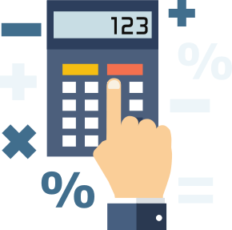
CPI
The most commonly used measure of inflation is Consumer Price Index.
How it works
  The base year is given an index of 100
  Each following year is also given an index.
Price of market basket (current year)
100
CPI
Price of market basket (base year)
Example
2000: The total market basket is 20 Euro (Base year). Index = 100
2006: The total market basket is 25 Euro (Current Year) Index = 125
Inflation increased by 25% from 2000 to 2006
Copyright Bananaomics

Slide 11
Practice
Good
Year 1
Year 2
Year 3
Bananas
$.25
$.50
$.75
Milk
$1.75
$2.50
$2.75
Bread
$2.00
$2.00
$2.50
Market Basket
$4.00
$5.00
$6.00
Calculate the market basket from our example. Use 1 as the base year.
Year 1 CPI:
Year 2 CPI:
Year 3 CPI:
Copyright Bananaomics

Slide 12
Practice
Good
Year 1
Year 2
Year 3
Bananas
$.25
$.50
$.75
Milk
$1.75
$2.50
$2.75
Bread
$2.00
$2.00
$2.50
Market Basket
$4.00
$5.00
$6.00
Calculate the market basket from our example. Use 1 as the base year.
Year 1 CPI: 100
Year 2 CPI: 125
Year 3 CPI: 150
Copyright Bananaomics

Slide 13
Practice
Good
Year 1
Year 2
Year 3
Bananas
$.25
$.50
$.75
Milk
$1.75
$2.50
$2.75
Bread
$2.00
$2.00
$2.50
Market Basket
$4.00
$5.00
$6.00
The index is then used to calculate the inflation rate.
Using the index calculates the inflation for each year.
Year 1 Inflation Rate to Base Year:
Year 2 Inflation Rate to Base Year :
Year 3 Inflation Rate toBase Year:
Copyright Bananaomics

Slide 14
Practice
Good
Year 1
Year 2
Year 3
Bananas
$.25
$.50
$.75
Milk
$1.75
$2.50
$2.75
Bread
$2.00
$2.00
$2.50
Market Basket
$4.00
$5.00
$6.00
The index is then used to calculate the inflation rate.
Using the CPI, calculate the inflation for each year
Year 1 Inflation Rate to Base Year: 0%
Year 2 Inflation Rate toBase Year : 25%
Year 3 Inflation Rate toBase Year: 50%
Copyright Bananaomics

Slide 15


Slide 16

CPI Weighted Index (HL Only)
Copyright Bananaomics

Slide 17
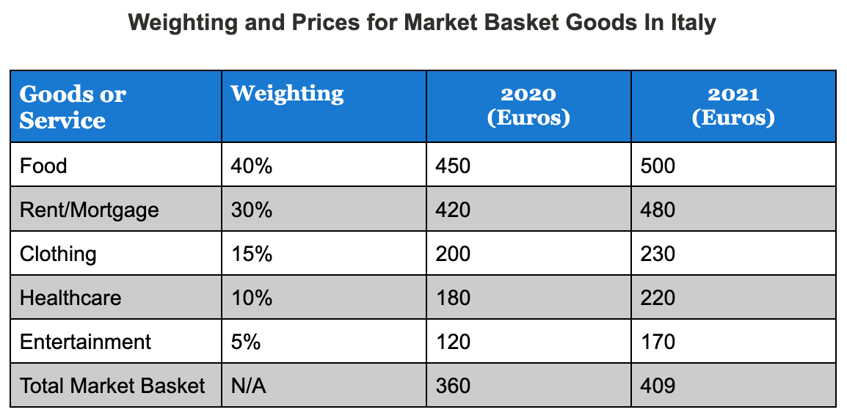
Weighted CPI
At times, market basket categories may be weighted to give a more accurate assessmeent
Copyright Bananaomics

Slide 18
Weighted CPI
Simply multiply the weight with the basket price
Market Basket for 2020
(450 x 0.4) + (400 x 0.3) + (200 x 0.15) + (180 x 0.1) + (120 x 0.5).
180 + 126 + 30 + 18 + 6 = 360
Calculate the inflation rate from 2020 to 2021.
Attempt to find it using the index system AND the percentage change formula.
Copyright Bananaomics

Slide 19
Weighted CPI
Calculate the inflation rate from 2020 to 2021.
13.61%
Copyright Bananaomics

Slide 20
Calculating a Weighted Price Index

Slide 21

Problems with CPI
Copyright Bananaomics

Slide 22

Problems With CPI
  Selection of Goods
    What are "typical household goods"?
  New Products
    CPI may not include the newest products in the market basket.
  Updates on Product Quality
    CPI does not account for the improvement in the quality of products that improve economic well-being.
Copyright Bananaomics

Slide 23

Practice Question
Copyright Bananaomics

Slide 24

A Refresher on Real GDP
Copyright Bananaomics

Slide 25
Real GDP/GNI
Calculated by using a "Deflator". These deflators essentially deflate the nominal values allowing for an accurate Real GDP.
Nominal GDP/GNI
________________
Real GDP/GNI =
X 100
Price Deflator (CPI)
Copyright Bananaomics

Slide 26

Paper 2 Math
Copyright Bananaomics

Slide 27

Causes of Inflation
Copyright Bananaomics

Slide 28
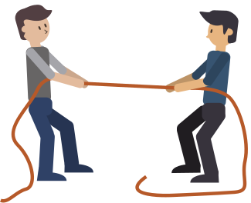



Two Types
Cost-Push
Inflation as a result of an increase in costs of production in the economy (Increase in price of raw materials, imports, or labour). Price Level is PUSHED UP.
Demand-Pull
Inflation as a result of an increase in AD (C, I,G, Xn). Price Level is PULLED UP
Copyright Bananaomics

Slide 29
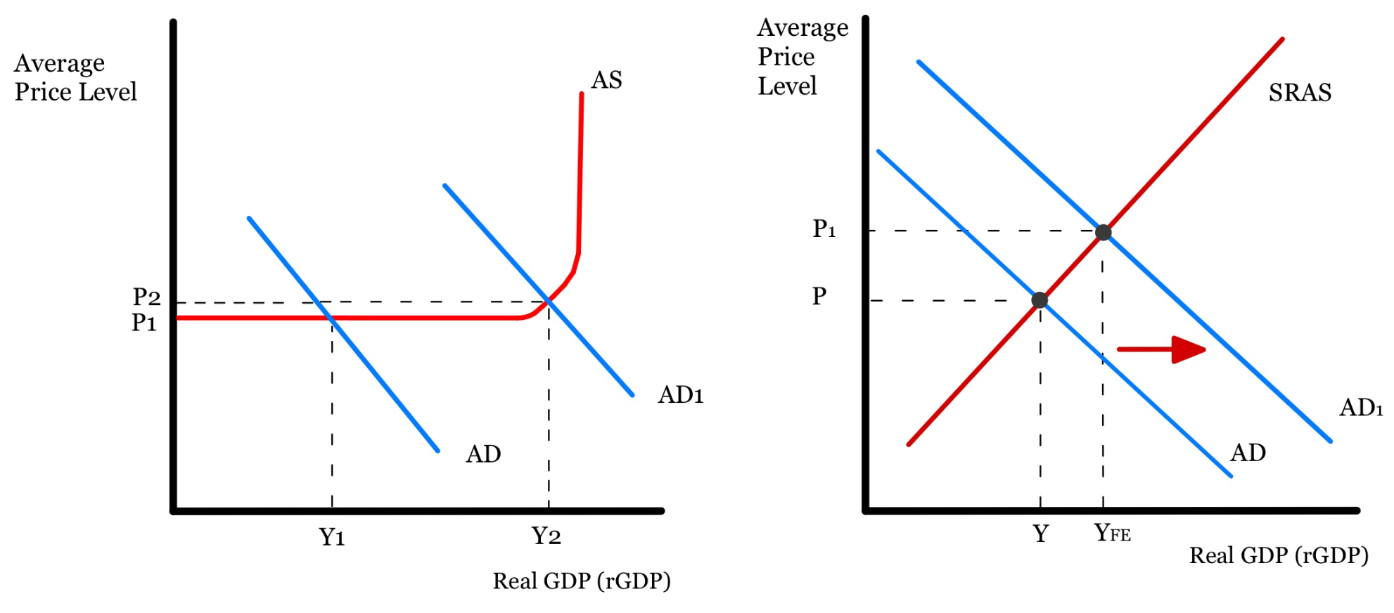
Demand-Pull
Inflation as a result of an increase in AD (C, I,G, Xn). Price Level is PULLED UP
Copyright Bananaomics

Slide 30
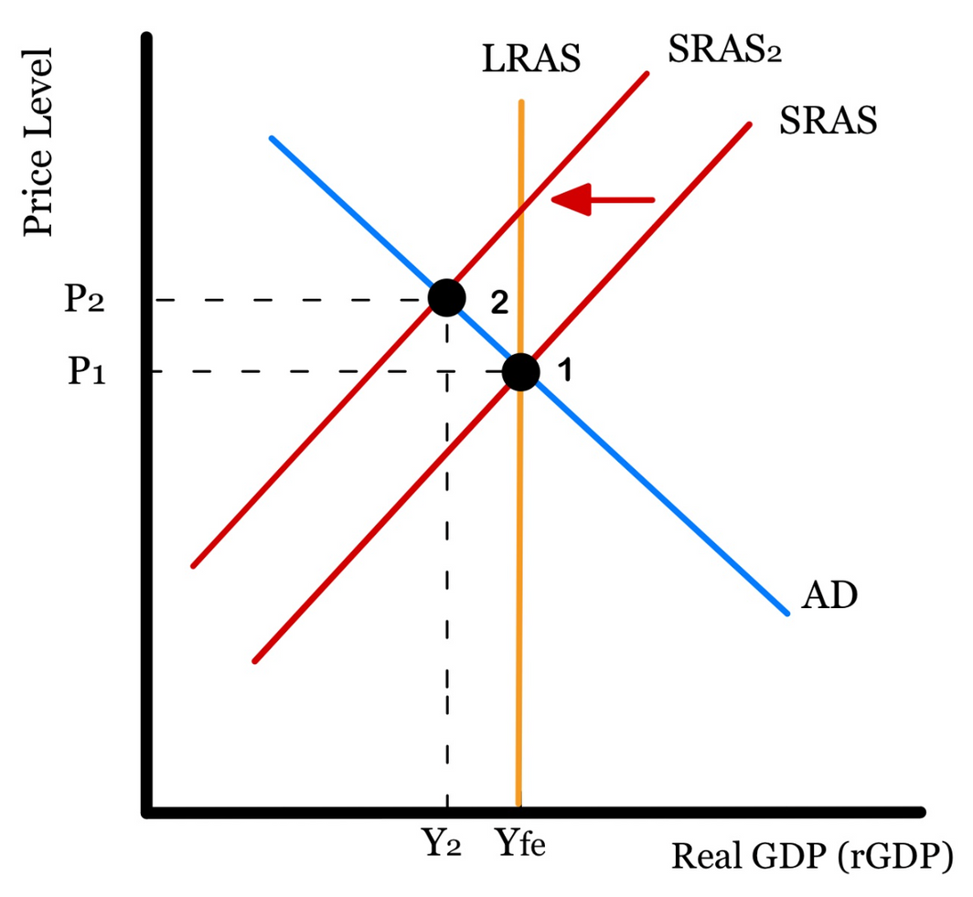
Cost-Push
Inflation as a result of an increase in costs of production in the economy (Increase in price of raw materials, imports, or labor). Price Level is PUSHED UP.
Copyright Bananaomics

Slide 31

Also note...
An increase in the money supply can also lead to inflation. If there is too much money in circulation, spending increased (Increase AD) resulting in inflation.
Copyright Bananaomics

Slide 32

Inflation Spiral
Copyright Bananaomics

Slide 33
Inflationary Spiral
Demand-pull inflation and Cost-push inflation combined
  As consumers drive prices higher, businesses also pay higher prices
  Additionally, workers demand higher wages due to the increase in the cost of living.
  These events fuel even more inflation
  The cycle builds on itself
Copyright Bananaomics

Slide 34
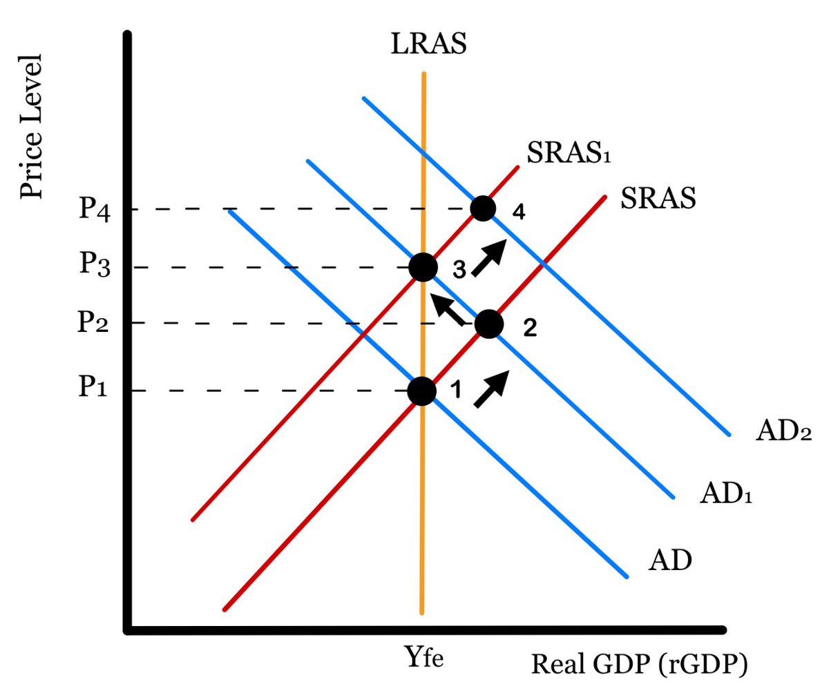
Inflation Spiral
Copyright Bananaomics

Slide 35

Cost of High Inflation Rate
Copyright Bananaomics

Slide 36
Costs of High Inflation
Uncertainty - Lack of confidence leads to businesses and consumers being careful.
Redistribution effects - Low-income households are affected more than higher-income households.
Savings effects - If the inflation rate is greater than an interest rate, you are better off not saving money.
Decrease in economic growth - A decrease in purchasing power and uncertainty leads suppliers and consumers to reduce economic activity.
Damage to exports - Inflation makes domestic goods more expensive for trading partners.
Copyright Bananaomics

Slide 37


Costs of Deflation
Copyright Bananaomics

Slide 38
Discuss the differences between deflation and disinflation.
Copyright Bananaomics

Slide 39

Costs of Deflation
Uncertainty - Lack of confidence leads to businesses and consumers being careful.
Deferred Consumption- Consumers defer to spend money as their money is gaining value.
Cyclical Unemployment- Deflation typically indicates falling economic output, meaning firms may have to lay off workers.
Increase in Real Value of Debt - Size of real debt grows as money gains in purchasing power.
Redistributive Effects - Winners: fixed income earners and lenders (banks). Losers: borrowers and providers of fixed incomes (e.g. government)
Policy Ineffectiveness - Even with the use of expansionary monetary and fiscal policies, it will be difficult to convince firms and consumers to borrow money.
Copyright Bananaomics

Slide 40

The Relationship Between Unemployment and Inflation
Copyright Bananaomics

Slide 41
Are the economic goals of low inflation and low unemployment in conflict with each other?
How?
Copyright Bananaomics

Slide 42

Potential Conflict Between Macroeconomic Objectives
  Low unemployment and low inflation
  High economic growth and low inflation
  High economic growth and environmental sustainability
  High economic growth and equity in income distribution
Copyright Bananaomics

Slide 43

Review!
Rules
  Don't use any economic terminology. Plain English
  Focus on the Concept, not definition
Copyright Bananaomics

Slide 44


Name That Concept
  Inflation
  Deflation
  Disinflation
  CPI
  Market Basket
Copyright Bananaomics

Slide 45


Name That Concept
  Purchasing Power
  Cost-Push Inflation
  Demand-Pull Inflation
Copyright Bananaomics

Slide 46

The Phillips Curve (HL Only)
Copyright Bananaomics

Slide 47
What happens to unemployment and inflation when AD increases?
Copyright Bananaomics

Slide 48
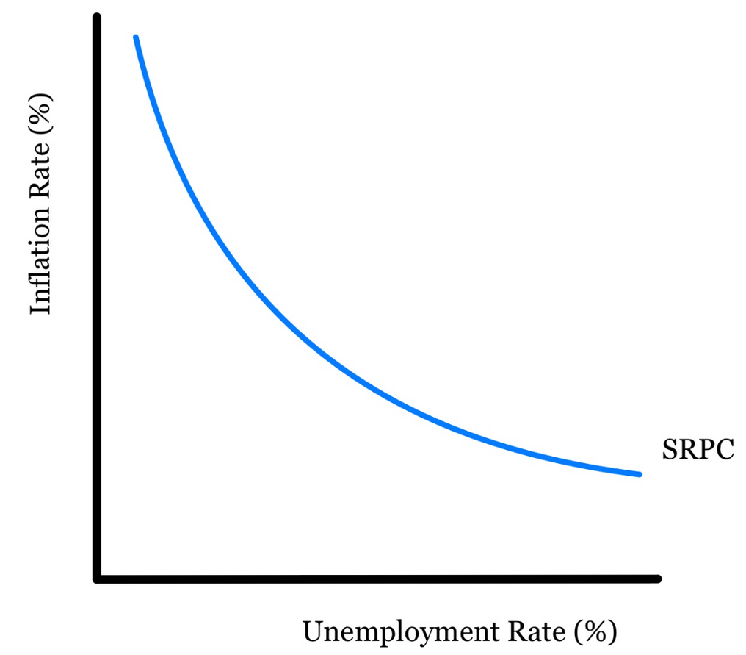
Phillips Curve
A diagram representing the relationship between unemployment and inflation.
Essentials of the Phillips Curve
  Inflation Rate (%) on Y-Axis
  Unemployment Rate (%) on X-Axis
  Two types of Phillips Curve
    Short-Run (SRPC)
    Long-Run (LRPC)
Copyright Bananaomics

Slide 49
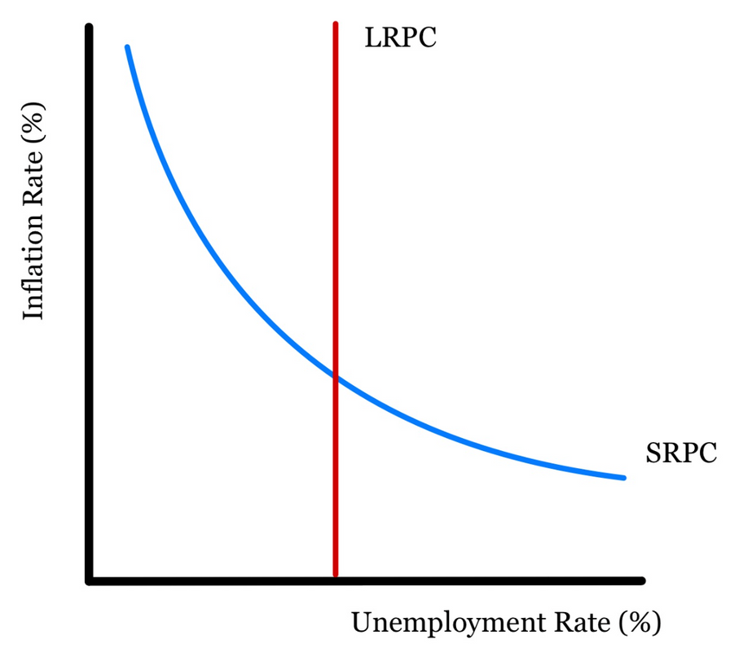
Phillips Curve
Long-Run Phillips Curve
This represents the idea that there is no trade-off between inflation and unemployment.
LRPC = Natural Rate of Unemployment (NRU) or Full Employment
Copyright Bananaomics

Slide 50

Practice
Copyright Bananaomics

Slide 51

Practice
Draw the effects of an increase of AD on a Phillips Curve?
Draw the effects of a decrease of AD on a Phillips Curve?
Copyright Bananaomics

Slide 52
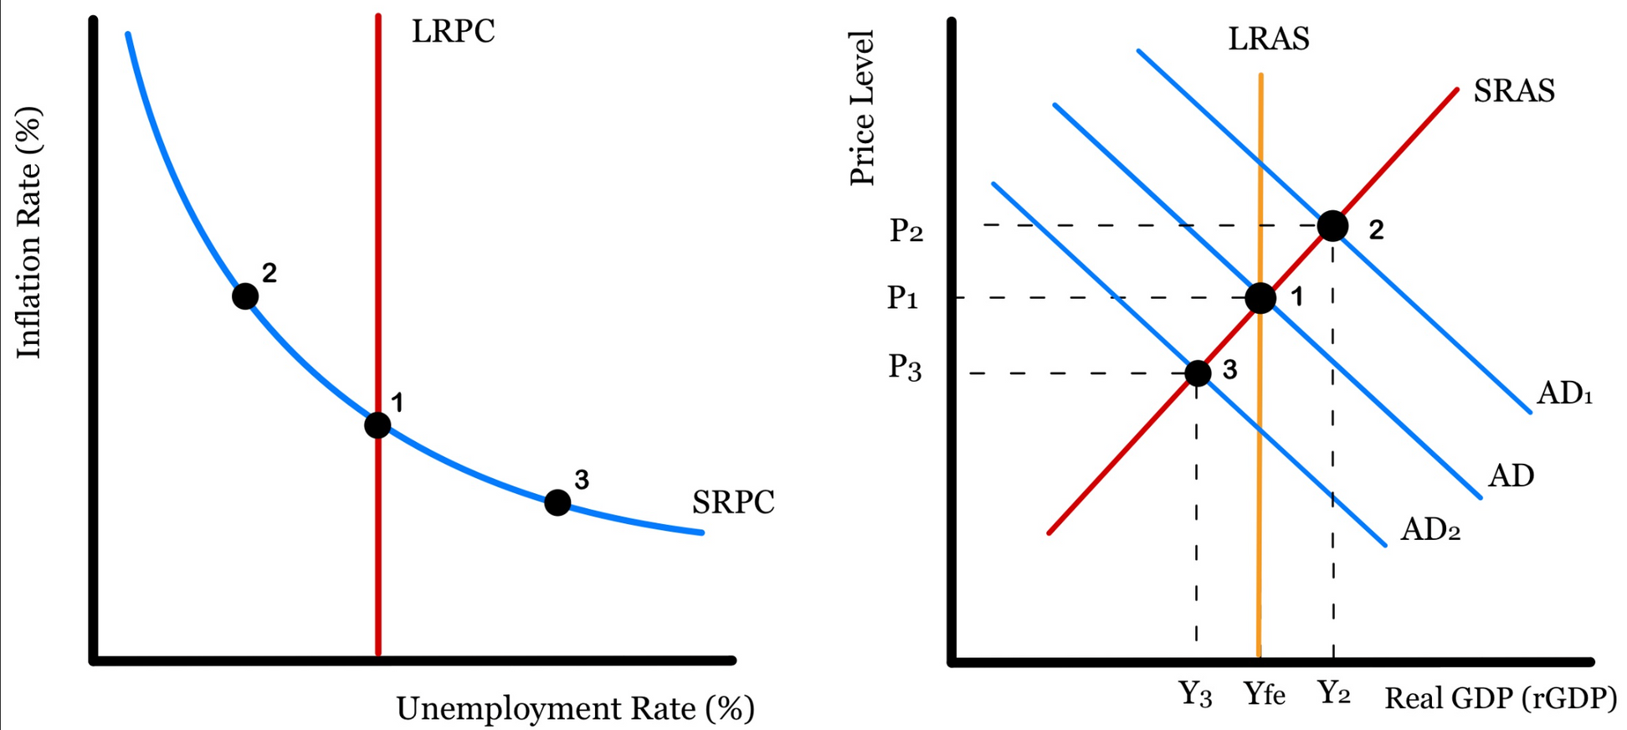
Practice
A change in AD results in movement along the Phillips Curve.
Copyright Bananaomics

Slide 53

Practice
Everything works fine until we experience a simultaneous increase of inflation and unemployment.
Draw the affect of stagflation on a Phillips Curve.
Copyright Bananaomics

Slide 54
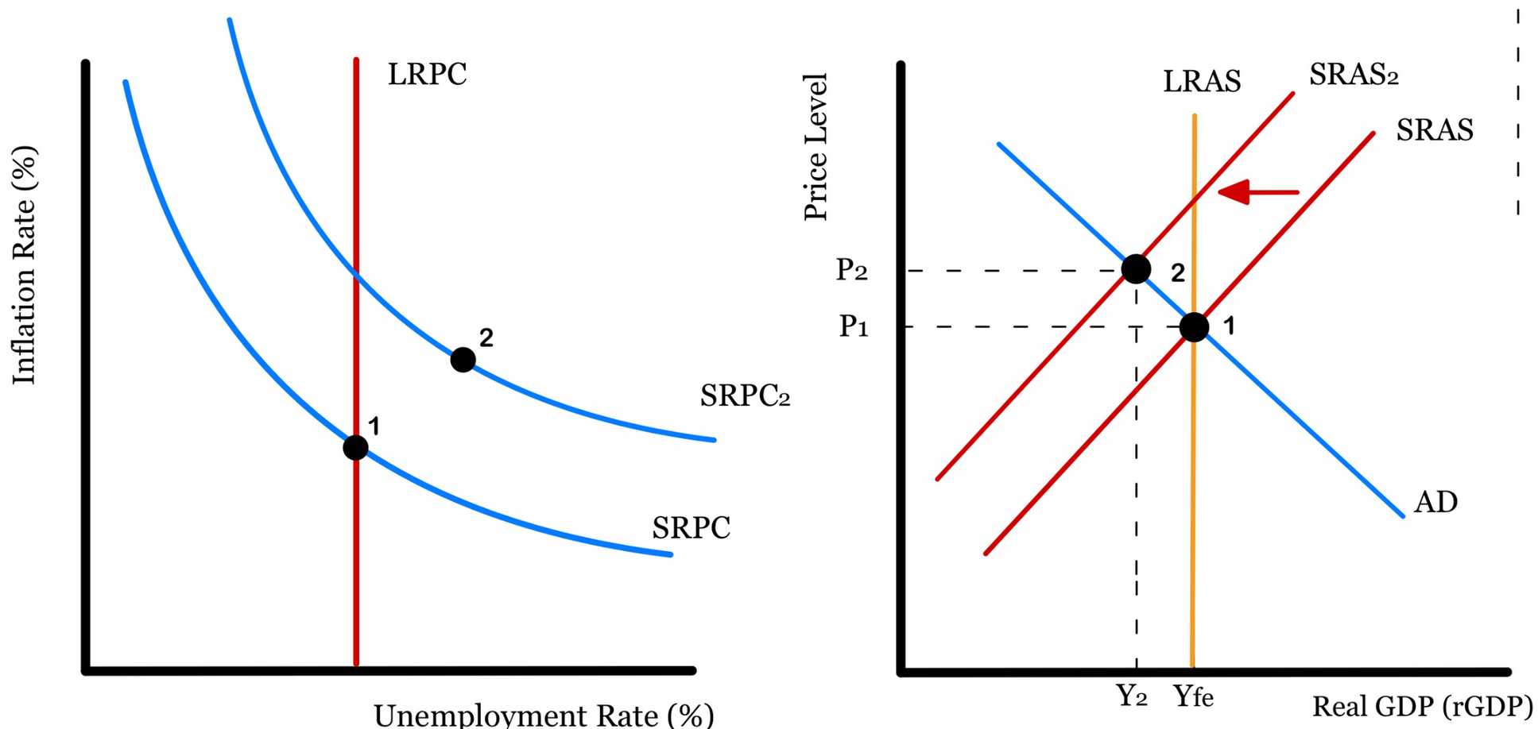
Practice
A change in SRAS results in shift of the Short-Run Phillips Curve.
Copyright Bananaomics

Slide 55
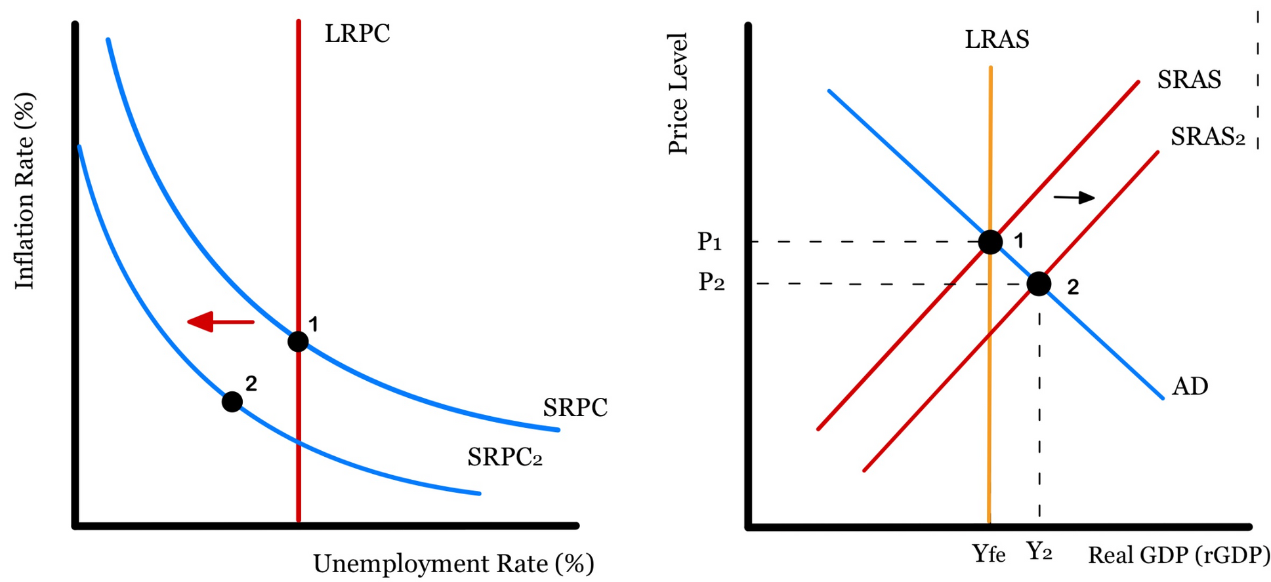
Practice
A change in SRAS results in shift of the Short-Run Phillips Curve.
Copyright Bananaomics

Slide 56

Practice
Draw the affects of an increase of AD with a long-run adjustment (neo-classical) on a Phillips Curve.
Copyright Bananaomics

Slide 57
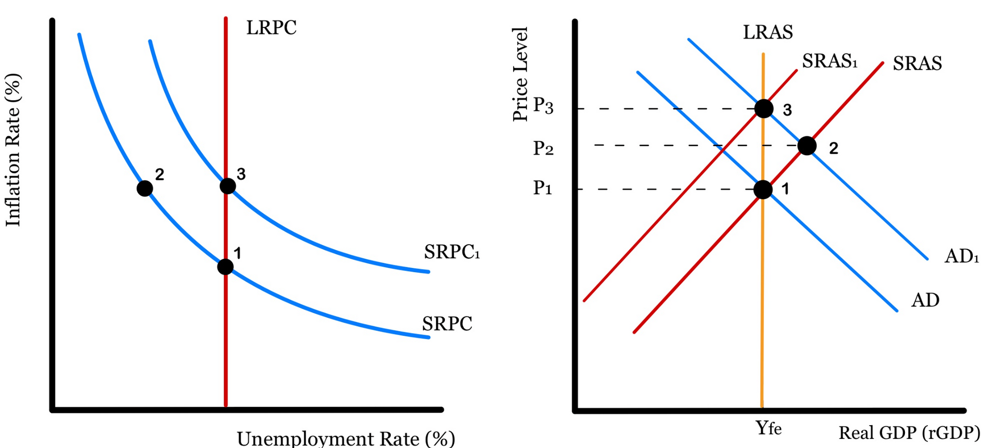
Practice
Neo-Classical Long-Run Adjustment to an increase in AD.
Copyright Bananaomics

Slide 58

Deficits and Debt (HL Only)
Copyright Bananaomics

Slide 59

Definition
Budget
The government creates a budget yearly that outlines their revenue and how they plan to spend money.
Budget Deficit = Government Spending > Government Revenue
Budget Surplus = Government Spending < Government Revenue
Balanced Budget = Government Spending = Government Revenue
Copyright Bananaomics

Slide 60
Debt-to-GDP Ratio
Government Debt is the cumulation of Government Deficits.
To measure the sustainability of government debt, the debt-to-GDP ratio should be used.
Debt
Debt-to-GDP ratio
GDP
The higher the ratio, the more difficult it will be to repay the debt
Copyright Bananaomics

Slide 61
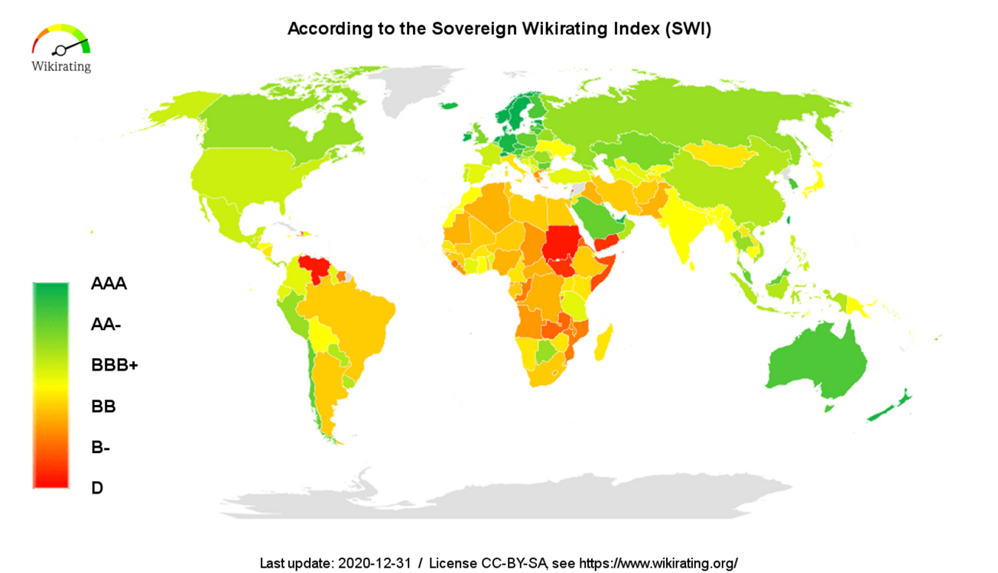
Cost of High Government Debt
Debt-Servicing Cost
As the debt-to-GDP ratio increases, more money must be paid to creditors to cover the interest. Debt-servicing is the repayment of principal/interest on the debt owed.
Credit Ratings
Countries have a credit rating similar to an individual's credit score. The rating represents an assessment of how likely a government is able to repay its debt.
Copyright Bananaomics
Source: Wikirating

Slide 62

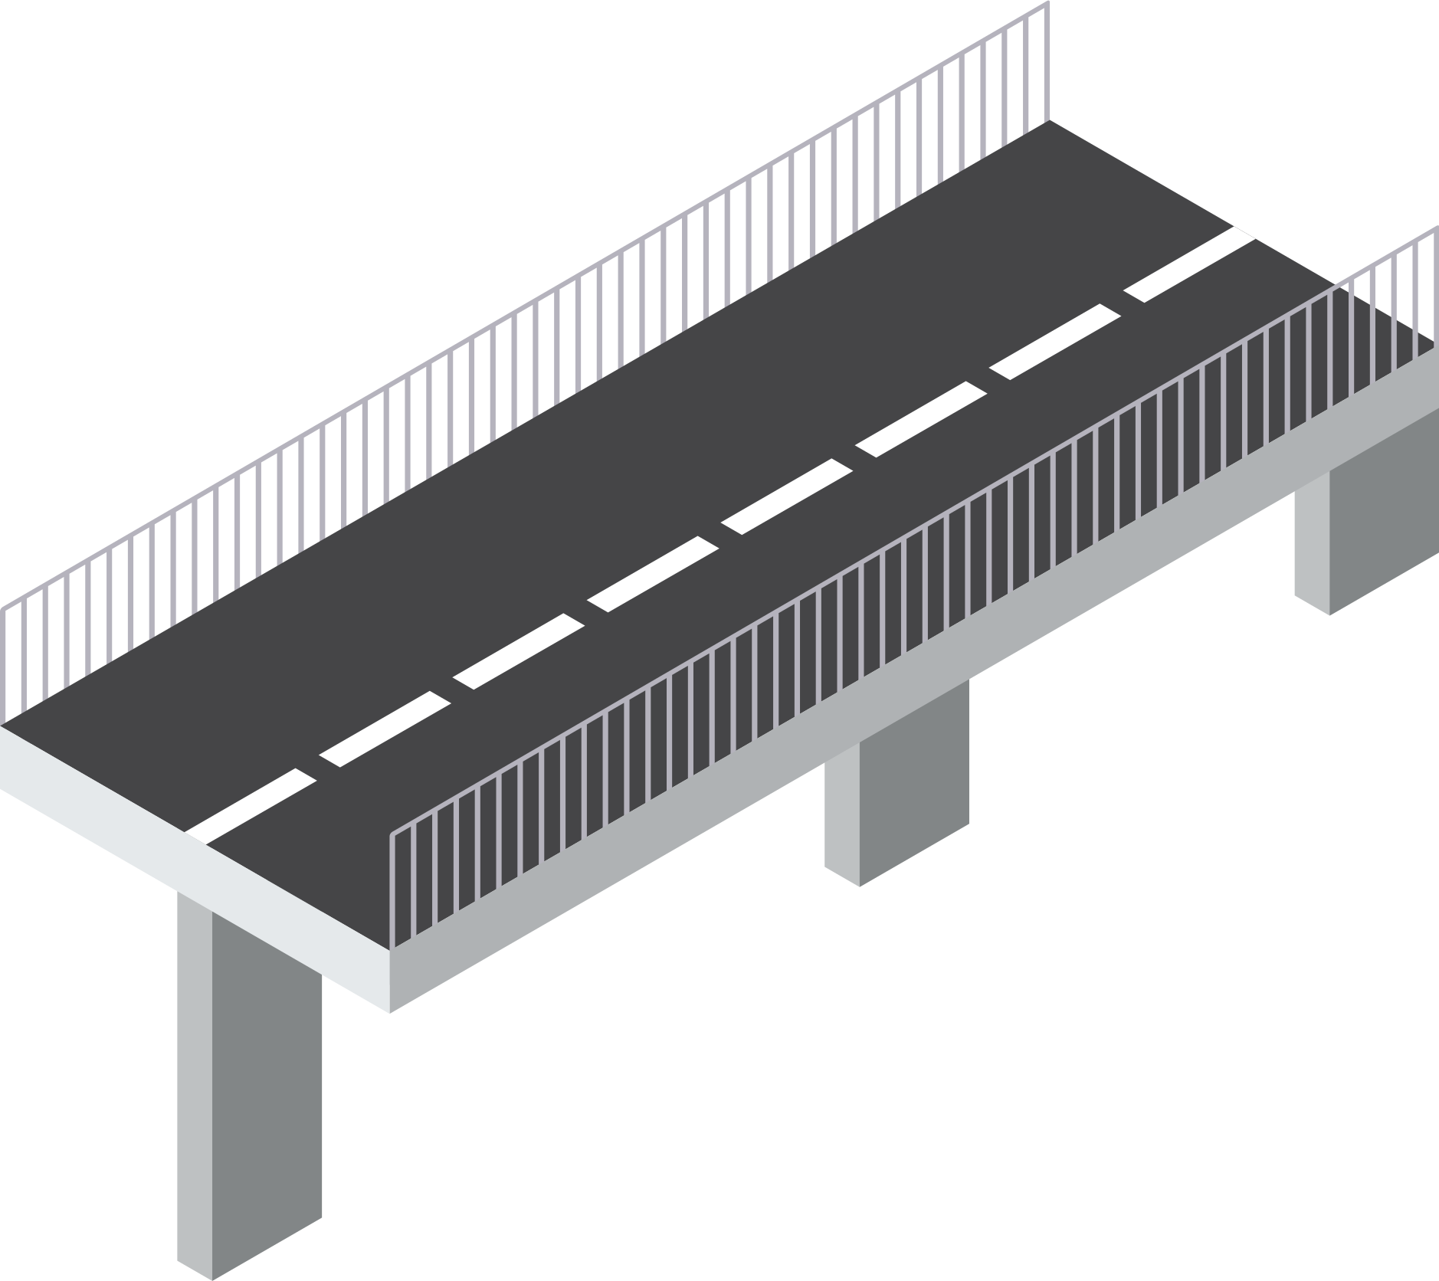

Cost of High Government Debt
Impacts on Future Government Spending
A government that must pay its debts is unable to use that money to promote economic growth by spending on Education, Healthcare, or Infrastructure.
Copyright Bananaomics

Slide 63

Methods To Know If Debt Is Sustainable
Some countries repay their debt back regularly, while others struggle to service their debts.
Factors that indicate the sustainability of debt
  Political Stability
  Composition of Debt (how long owed? internal or external debt?)
  Vulnerability (Countries that rely heavily on trade)
Copyright Bananaomics

Slide 64
Practice Question
Copyright Bananaomics

Slide 65
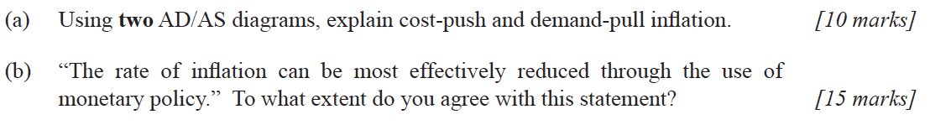
Paper 1
M14/3/ECONO/HP1/ENG/TZ1/XX
Copyright Bananaomics

Slide 66
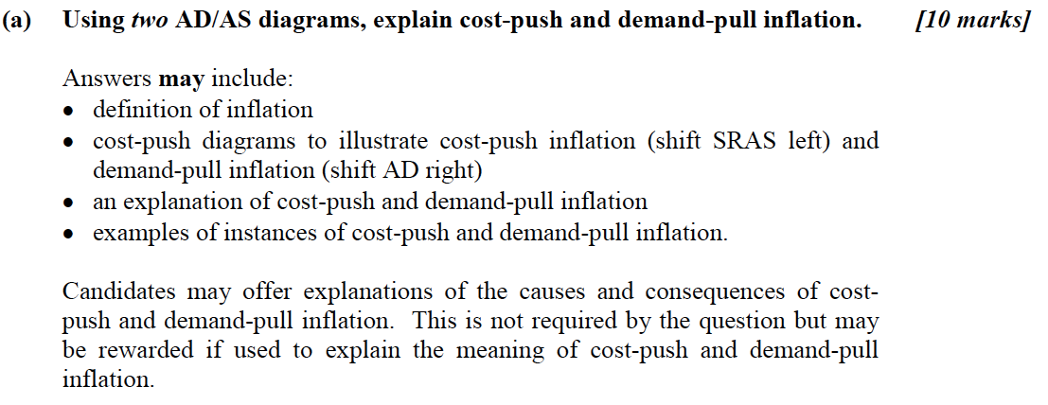
Mark Scheme
Copyright Bananaomics

Slide 67
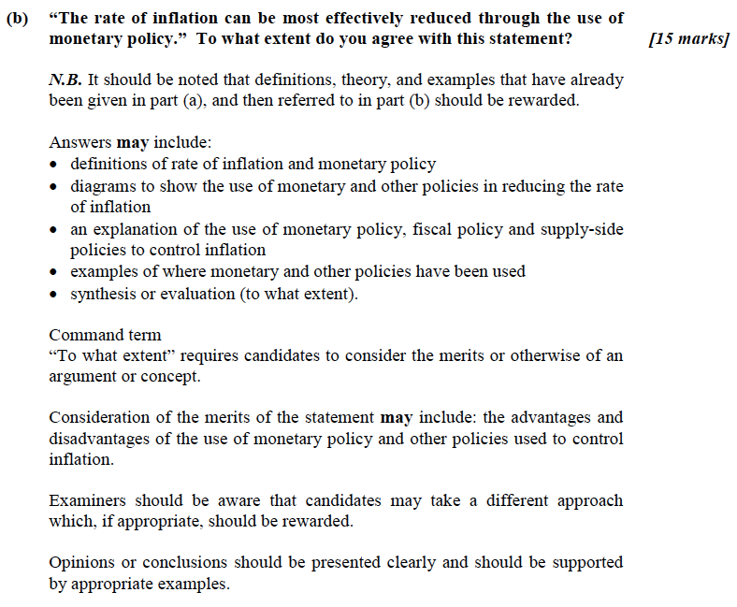
Mark Scheme
Copyright Bananaomics

Slide 68

Enjoying The Content?
Visit bananaomics.com to purchase package deals with discount prices!
BANANAOMICS

